Slide 1
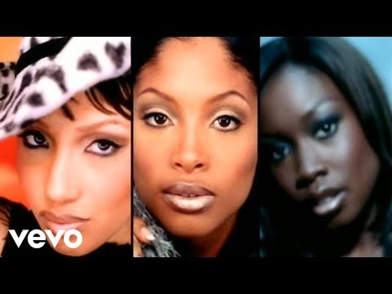
Black women: College experiences and academic engagement
November 17, 2023
ICCCA Conference
This Photo by Unknown author is licensed under CC BY-NC-ND.

Slide 2
Land Acknowledgement
We respectfully acknowledge the ancestral homelands of the Peoria, Kickapoo, Sauk, Mesquaki, Kaskaskia, Miami, and other Native Peoples. We recognize the longstanding significance of these lands for Indigenous Peoples past, present, and future. Historical awareness advances education that invites truth.

Slide 3
Research study rationale
Limited scholarly research studies focused on black women enrolled in college
Notable differences in college experiences for black women

Slide 4
Research Purpose: How does the lived experience of black women influence their college experiences and academic engagement?

Slide 5
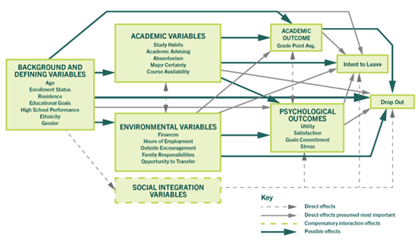
Nontraditional and Commuter College Student Engagement Model
Source: Metzner and Bean (1987)

Slide 6
Four Factors for Academic Engagement
Autonomy and self-determination
Academic supports
Faculty trust
Student effort
This Photo by Unknown author is licensed under CC BY-ND.

Slide 7
Gendered Racial Experiences
Psychological effects
"the only one" and "Strong Black woman"
Personal agency
Self-awareness, esteem and confidence

Slide 8
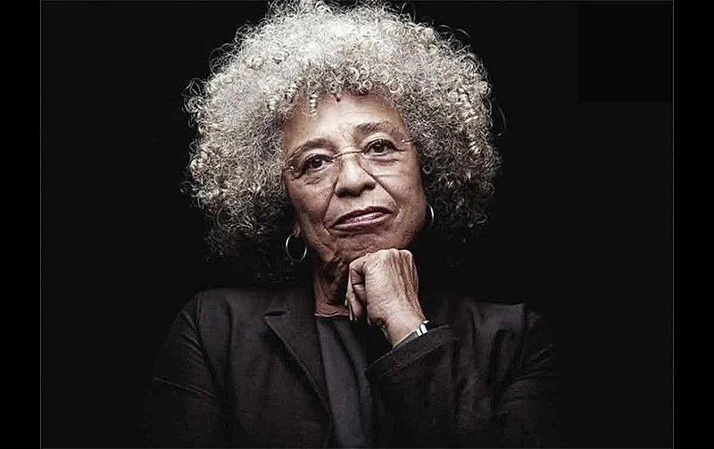
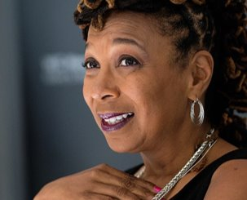
Theoretical Frameworks
Black feminist theory
Patricia Hill-Collins
Intersectionality theory
Kimberly Crenshaw
Identity centrality theory
Stereotype threat theory

Slide 9
Qualitative research methods:
Descriptive phenomenological approach – Edmund Husserl
Adequate description of the phenomenon
Reflections and meanings of experiences in the context of the phenomenon
This Photo by Unknown author is licensed under CC BY-ND.
Notes:
.

Slide 10
Data Collection:
Researcher Approach | Interview Structure | Method | Example Question
Acceptance of natural attitude of participants | Contextualization (Eliciting the lifeworld in natural attitude) | Descriptive/Narrative context questions | “Tell me about becoming ill,” or “Tell me how you came to be at the satellite unit.”
Reflective critical dialogue with self | Apprehending the phenomenon (modes of appearing in natural attitude) | Descriptive and structural questions of modes of appearing | “Tell me about your typical day at the satellite unit,” or “Tell me what you do to get ready for dialysis.”
Active listening | Clarifying the phenomenon | Imaginative variation: varying of structure questions | “Describe how the unit experience would change if a doctor was present at all times.”

Slide 11
Results
Three classroom or on-campus themes:
The use of stereotypes
The presence or lack of diversity
The feeling of being dismissed
Notes:
Before I talk about my research results
Brief overview of the 10 participants background.
Ages ranged from 22 to 68 – so traditional aged enrolled FT to adult age student enrolled PT in leisure or professional development courses
Participants educational level were from having no credential all the way to a terminal or doctoral degree
Black and Bi-racial black
Heterosexual woman, gender fluid, and non-binary
Family and upbringing experiences that uniquely influences their vast identities and behaviors as black women enrolled in college.
Reflecting various levels of cultural values and centrality to racial and gender identities
2nd phase - phenomenological research design was to understand the phenomenon as experienced – that is the college experiences of these 10 participants.
To that end, through my data collection methods and thematicizing the result, these three themes emerged relevant to their college experiences.

Slide 12
Results distribution
 |  | Classroom or on-campus themes
Participant | Number of classroom or on-campus experiences described | The use of stereotype | The presence or lack of diversity | The feeling of being dismissed
One | 1 | - | 1
Two | 1 | - | - | 1
Three | 4 | 4 | - | -
Four | 1 | 1 | - | -
Five | 2 | 1 | - | 1
Six | 1 | - | 1 | -
Seven | 1 | - | 1 | -
Eight | 1 | 1 | - | -
Nine | 3 | 2 | 1 | -
Ten | 2 | 1 | 1 | -
TOTAL | 17 | 10 | 5 | 2

Slide 13
The Use of Stereotypes:
Participant 3 described an experience while attending a four-year university:
When the freshman students arrived in the fall, we were assigned lodging. While respectful, there were questions about my hair routine. Also, there was a sense of needing to go out of their way to commune with students of color
Participant 5 described an experience while attending her community college:
The student club advisor offered me a position as the president. I was honored and accepted. But during my time with the club, I felt pushed around and used. The advisor would talk over me or disregard my requests. So I eventually resigned. My family experience was projected here when I subscribed to the matriarch system of “black unity” ideology within the student club.

Slide 14
The Use of Stereotypes:
Participant 9 described an experience while attending her four-year university.
There was an event for graduating students. Excited, I walked towards a table passing out honor cords, and two administrative members looked up at me and then continued engaging in conversation. Being patient, I waited. After a while, they looked back at me, and I began to say something when one of them cut me off. In a condescending tone, he asked for my student ID and said, “we can’t just be giving anything to anybody, y’ know? You might be a student. You might not.”
Participant 10 described an experience while attending her community college:
The advising staff questioned my ability to speak other languages. There was a level of surprise when she learned that I have a facility for learning languages and that I'm moderately fluent in Spanish. She began to question my background and why I wanted to learn Spanish. She became more flustered when I indicated that I would be taking three classes while working full-time. I assured her I had a plan and was ready to move forward, but she probed further and asked whether I had children.

Slide 15
The Presence or Lack of Diversity:
Participant 1 described their experiences while attending her community college.
I finally saw diversity. I saw classmates and professors that looked like me. I saw students and professors with different racial and ethnic backgrounds. I saw students of all ages: mothers, fathers, elders, etc. For once, I felt comfortable in my skin, my background, and my identity. I did not have to pretend that I was someone I was not.
Reflection: I had the best grades ever in my entire life. I was so focused. It was a great experience, and I instantly started to bond. It made me feel a sense of belonging, and I felt worthy and was no longer insecure about myself.

Slide 16
The Presence or Lack of Diversity:
Participant 6 also described an experience while attending her community college.
I am enrolled in a class that has four people. The professor and the students are culturally diverse and aware. Because of this, we can talk about topics on gender and racial identity. We talk about what is whiteness and privilege. We get into deep conversations about different identities and injustices.
Reflection: I was very open to conversations because I wouldn't be judged. I knew that they would understand and respect my opinion. This is the first time in my college career that I felt understood. I enjoyed class so much that I wrote a paper to the professor thanking her for creating an atmosphere that was free and understanding.

Slide 17
The Presence or Lack of Diversity:
Participant 7 described the lack of diversity while attending her four-year undergraduate and graduate institutions.
I was the only black female student in a class of 80 people for my undergraduate degree at a school of physical therapy and the only black student while pursuing my master's in physical therapy. Half of my years as an undergraduate and graduate student were filled with insecurities, anxiety, fear of failure, and isolation.
Participant 7 spoke about the experience of attending her four-year and graduate institutions and being in an academic program that lacked gender diversity in career pathways typically dominated by white men, but how, over time and reflection, she now engages at her community college:
I believe the bulk of all the emotions were derived from my need to constantly prove myself when relating to other students and staff. Those emotions are long gone now that I am retired with many achievements and successes over the years. It took my successful journey to lose that baggage.

Slide 18
The Feeling of Being Dismissed:
Participant 2 described an administrator's response to her after reporting an incident with a male student:
In great detail, she described this student's family life, how many siblings they had, and the genders of the siblings, and from her mouth, she told me the student "was raised to be very respectful toward women." She tried to assure me that the behavior I experienced and witnessed was misinterpreted.
Participant 2 perceived two outcomes from her experience.
All the administrator had to tell me was that she'd spoken to him and told him what behavior was ok and what wasn't. Instead, she chose to invalidate my experience. No one wants to admit that even a student with good grades, friends, and a positive demeanor can be deceitful. Why should I be hypervigilant when everyone else gets to be in class safely and comfortably?

Slide 19
The Feeling of Being Dismissed:
Participant 9 described while attending her four-year university:
I ran for student trustee and made it to final interviews with four members of the university’s board of trustees. When describing my community college accomplishments, one of the board members snidely commented, “your junior college?"
Participant 9 explained:
It was astonishing to see an advocate for higher education diminish someone else’s academic achievements. A community college, especially for black women, provides an opportunity to obtain a four-year education and other professional work experiences and caters to the needs of marginalized students.

Slide 20
Results
Three themes related to four factors of academic engagement:
Letting go of baggage
Developing self-agency
Navigating learning experiences

Slide 21
Results distribution
 | Three themes
Four factors that influence black women and academic engagement | Letting go of baggage and creating self-identity | Developing Self -agency | Navigating learning experiences
Autonomy and self-determination (ASD) | 5 | 11 | 15
Faculty trust (FT) | - | - | 25
Academic support services (AS) | - | 13 | 5
Student effort (SE) | 9 | 22 | 7
TOTALS | 14 | 46 | 52
Notes:
1. Letting go of baggage and creating self-identity: This refers to releasing past gendered racial identity experiences that prevent and hinder the development of an individual black woman's identity.
Developing self-agency: This refers to tapping into those innate and gendered racial experiences to develop self-sustaining action through:
Building connections: This refers to cultivating a network of academic, personal, and other support systems, as well as what it is like to sense a feeling of belongingness.
Focusing on goals means understanding purpose and achieving authenticity while navigating learning experiences.
Navigating learning experiences: This refers to being agile while understanding the role of self-awareness, personal experiences, and interpretation of those experiences in deciding how to traverse academic engagement.
Understanding context: This refers to accepting social conditions and experiences outside of a student's control, whether they are stereotypes and biases or the lack of ability to empathize due to the limitation of lived experiences from other students, faculty, and staff. Acceptance does not convey agreement but only accepting that you have no control over the other person's perceptions.

Slide 22
Letting Go of Baggage & Creating Self-Identity
Participant 1 reflected on how she deals with being the only one or one of the few black women in her college classes and when she is called on to offer her perspective.
It makes me feel pressured and overwhelmed. I was careful about what I said, and didn’t want to say the wrong thing. I didn’t like it when that happened in high school. It would affect me the whole day, and I would keep thinking about that class discussion. If that happened today, I could let that go because I’m a person at the end of the day. I don’t feel like I should represent everyone and their opinion.
Participant 1 was asked to explain what made the biggest difference between her earning less than a 3.0 GPA in high school and her 3.9 GPA at her community college. She explained that:
I was never comfortable with my racial identity in the field or classroom. However, going to my community college, I developed that comfort, which contributed to my academic success. I wasn't scared to make a mistake in class or if I said the wrong answer. I tried harder and didn't doubt myself anymore.

Slide 23
Letting Go of Baggage & Creating Self-Identity
Participant 2 also reflected on what it is like being the only one, or one of few, black women in a classroom in two different situations.
Situation one: It is a burden to feel like I have to be the voice when sometimes I just want to be a regular student like everyone else. I don't want to have to be a teacher as well, but it feels like I don't have a choice when I'm being taught by people who cannot or who don't have the perspective that I have. So, even though they may be very well learned, they may have many degrees, but because they don't have my lived experiences, they're going to have blind spots.
Situation two: I can understand non-black women's experiences, but I can't expect them to understand me. I was wearing a band t-shirt one day, and my instructor asked if I knew that band. I don't think she meant it negatively, but she said, "Oh, you're full of surprises. She made an assumption based on my racial identity. Those assumptions can get in the way of your education because people don't see you as a person first.
Participant 2 reflected on the relationship between her identity concerning academic success.
Studying harder could help my grades, but it wouldn't necessarily equate to success in class. I understand that the grading system measures the quality of work, but I got very good grades in a class from which I got nothing. Successful black women are expected to work harder than everyone else. But I don’t think that makes me who I am. It's something that I'm doing in response to my surroundings. I am doing it for survival. I don’t want to be extra resilient. I just want to be myself and the world to work for me as it does for others.

Slide 24
Letting Go of Baggage & Creating Self-Identity
Participant 2 reflected on the relationship between her identity concerning academic success.
Studying harder could help my grades, but it wouldn't necessarily equate to success in class. I understand that the grading system measures the quality of work, but I got very good grades in a class from which I got nothing. Successful black women are expected to work harder than everyone else. But I don’t think that makes me who I am. It's something that I'm doing in response to my surroundings. I am doing it for survival. I don’t want to be extra resilient. I just want to be myself and the world to work for me as it does for others.

Slide 25
Letting Go of Baggage & Creating Self-Identity
Participant 5 reflected on the underrepresentation of black artists in her class curriculum.
I noticed that most known artists are white, but do I kick up dust about this. I'm content knowing I can be one of those black artists others look up to. I can get inspiration from artists in general, other cultures, other people, and other genders. So I'm not going to limit myself to just black artists anyway. So that’s why it’s not worth my peace. You only have a certain amount of energy in a day.
Further, Participant 5 spoke about her black woman identity through self-reflection and self-awareness.
You don’t know where you’re going when you’re not self-aware. The social norms and trends are just leading you. So when you’re self-aware, you can step back and ask yourself questions about the decisions that you’re making and take accountability for them instead of letting life happen. When I’m self-aware, I don’t have to worry about making those bad decisions and feeling the bitterness and all the hate and anger I used to feel. I always seek true peace.

Slide 26
Letting Go of Baggage & Creating Self-Identity
Participant 5 discussed how assumptions, biases, and stereotypes cause harm.
It’s like a knot and then a cycle of these events that you are unaware you’re doing….It is just you’re so used to it. So you can limit yourself by not being self-aware of negative energy. And you can become limitless when you are more aware of your self-identity.

Slide 27
Developing Self-Agency
Participant 1 reflected on her college-level math readiness and how she eventually excelled in her math courses.
I always struggled with math, but I was required to attend study hall or tutoring as a freshman athlete. All of my friends decided on study hall, but I decided to go to tutoring because I was falling behind in math. I went there probably three times a week for two years. Even when it was virtual, I was on Zoom getting tutored. I ended up getting A's in both of my math classes.
If it wasn't for soccer, I don't think I would have been there. Also, there were some instances on class assignments where I would get a low grade. I would address it with my professor, and they allowed me to make corrections to get a better grade. That definitely made me work harder. I just knew that I had to pass to stay eligible to play soccer, so that contributed to my academic success.

Slide 28
Developing Self-Agency
Participant 6 reflected on how gender-racial representation and a feeling of belongingness influenced her level of college satisfaction and academic engagement:
Being at a four-year university compared to my community college was completely different. I don't see a lot of black women. It's not just other black people, but seeing other races and having better representation. That was helpful at my community college because I saw women who looked like me, and I'm still connected with them today. Those resources are vital. That sisterhood that I had at my community college is not here, but I know I have people I can rely on. So even in my classroom, I find people that are like me, they don't have to look like me.

Slide 29
Developing Self-Agency
Participant 10 reflected on how aspects of her cultural identity were infused in the classroom content and curriculum and the skillfulness of one faculty member.
She took the time to talk about Ebonics and African American vernacular and not let it be a footnote. She was driving deep discussion and then allowing there to be readings. That was a shift because I didn't realize I needed to hear that validation. She talked about code-switching and all of those things I had learned to do in language and my life, but she gave voice to it, which was very meaningful. So I was excited to come to class. She did a masterful job of giving voice to voices different from her own and even acknowledging her lack of knowledge. That affirmed me as a black woman and elevated my view of the black language.

Slide 30
Navigating Learning Experiences
Participant 2 reflected on two experiences and how she responded in both situations.
Last semester I had two instructors, one I trusted a lot. She cared about our class and me as a student. I was willing to participate and share personal information or make simple connections. You have to show me that I'm not going to feel weird about sharing parts of myself. I did positively because of it.
The instructor tried his best in the other class, but I did not trust him. I didn't feel safe asking questions and dreaded going because we didn't have a positive relationship. When I asked questions, he was short, aggressive, ornery, maybe. I don't think it targeted me, but it was his general demeanor. Participation in his class was also important, but I kept it to a minimum. I'm not sure that it affected my grade hugely. I just powered through even though I felt uncomfortable with the instructor. I would still try to participate when I felt like I had it in me that day.

Slide 31
Navigating Learning Experiences
Participant 3 reflected on the dynamics between academic engagement, her gendered racial identity experiences, and faculty feedback.
Often when it comes to academics, I let myself go where energy flows to help propel me to success in that class. Some of that comes from my black experience or female experience lens, and I'm not going to shy away from that. The feedback I get from you is on you, but I'm going to do me as respectfully as possible.
She further explained the process for responding to her classroom experiences.
It's balancing internalized stuff and not resonating internalized stuff within other people. Also, doing you, but subverting expectations, being aware of stereotypes, and tiptoeing around those. It's like waffling between tiptoeing and I don't care or appearing to be an angry black woman. But also not appearing meek and letting people trample all over you.

Slide 32
Navigating Learning Experiences
Participant 4 reflected on her experiences with processing faculty feedback.
Most people would be, you're right because it's coming from the professor, but not me. Because not all the time can they see your point of view. Maybe I'm coming from an angle you haven't heard yet or don't understand.
Sometimes I'll listen to my professors like, you know what? I did have a little trouble writing this paper; you could be right. Let me re-evaluate some things. But suppose I felt like I put my heart into this assignment, and a professor came out with feedback that's on the opposite angle of what I was trying to do. In that case, I will submit it anyways and then grade me accordingly because I'm giving you what I believe is my best work.

Slide 33
Five Conclusions
Intrinsic motivation
Personal growth and development that was self-defined
Varied and situational coping and navigating strategies
Constant refining of self-definitions and personal identities
Support for Metzner and Bean (1987) model that includes background variables as possible effects student persistence
Notes:
There are five key conclusions based on the data analysis and results.
The first is that the participants in this study demonstrated intrinsic motivation across their varied self-definitions of being a black woman attending college and their college experiences.
The second is that participants expressed personal growth and development that was unique to their past experiences in their backgrounds and how they use those experiences to traverse their college experiences.
Third, each participant used varied and situational coping strategies to overcome gendered racism in the classroom or on-campus that was responsive to their past experiences and their self-defined identities.
Fourth, all participants consistently refined their self-definitions as resistance to stereotypes of black women and typecasts roles of black women generally and the ideal college student.
Finally, this study’s analysis and results supports Metzner and Bean’s (1987) nontraditional and commuter college student engagement model, specifically that background variables have possible effects on college satisfaction and academic outcomes or engagement relative to black women enrolled in college. ​

Slide 34
Recommendation
The more flexible, adaptive and responsive classroom or on-campus experiences, the more opportunities for black women to demonstrate academic engagement and therefore better able to navigate their learning experiences.

Slide 35
Researcher’s Concluding Questions
Given the many paths students have and the varying factors that impact a student’s ability to succeed, what types of professional development should colleges implement to provide equitable support for all students?
How can colleges create transformational change and inclusive learning spaces for students in Higher Ed?
What should college instructors teaching at PWI’s do to unlearn the system of anti-Blackness and white supremacy to develop their anti-racist lenses and better serve their students?
How would colleges consider generational differences among students in creating culturally responsive andragogy and campus experiences that support the retention, persistence and completion agenda?

